Slide 1

Predicting Flight Cancellations with Weather and Employee Data
Presented by Bimalsen Rajbhandari, Garret Gao, Jake Sprecher, Matt Zhang

Slide 2
Agenda
Business Problem
Executive Summary
Problem Statement
Data Preparation and Analysis
Data Cleaning
Machine Learning Models
Random Forest
Conclusion
Data Sources
Feature Engineering
Exploratory Data Analysis
XGBoost
Limitations
Logistic Regression
Future Work
Notes:
This is a quick overview on our agenda today. We will cover data profile, introduction on the methods and models we used. After that, we will interpret the results and discuss about the limitation and future works.

Slide 3
Executive Summary
Business Problem
Data Preparation and Analysis
Machine Learning Models
Conclusion
Predict flight cancellations based on weather and airline employees
Achieve 65.7% recall score
Domestic flights for 10 airlines from 2018-2022
Using inputs that are predictable days before the flight

Slide 4
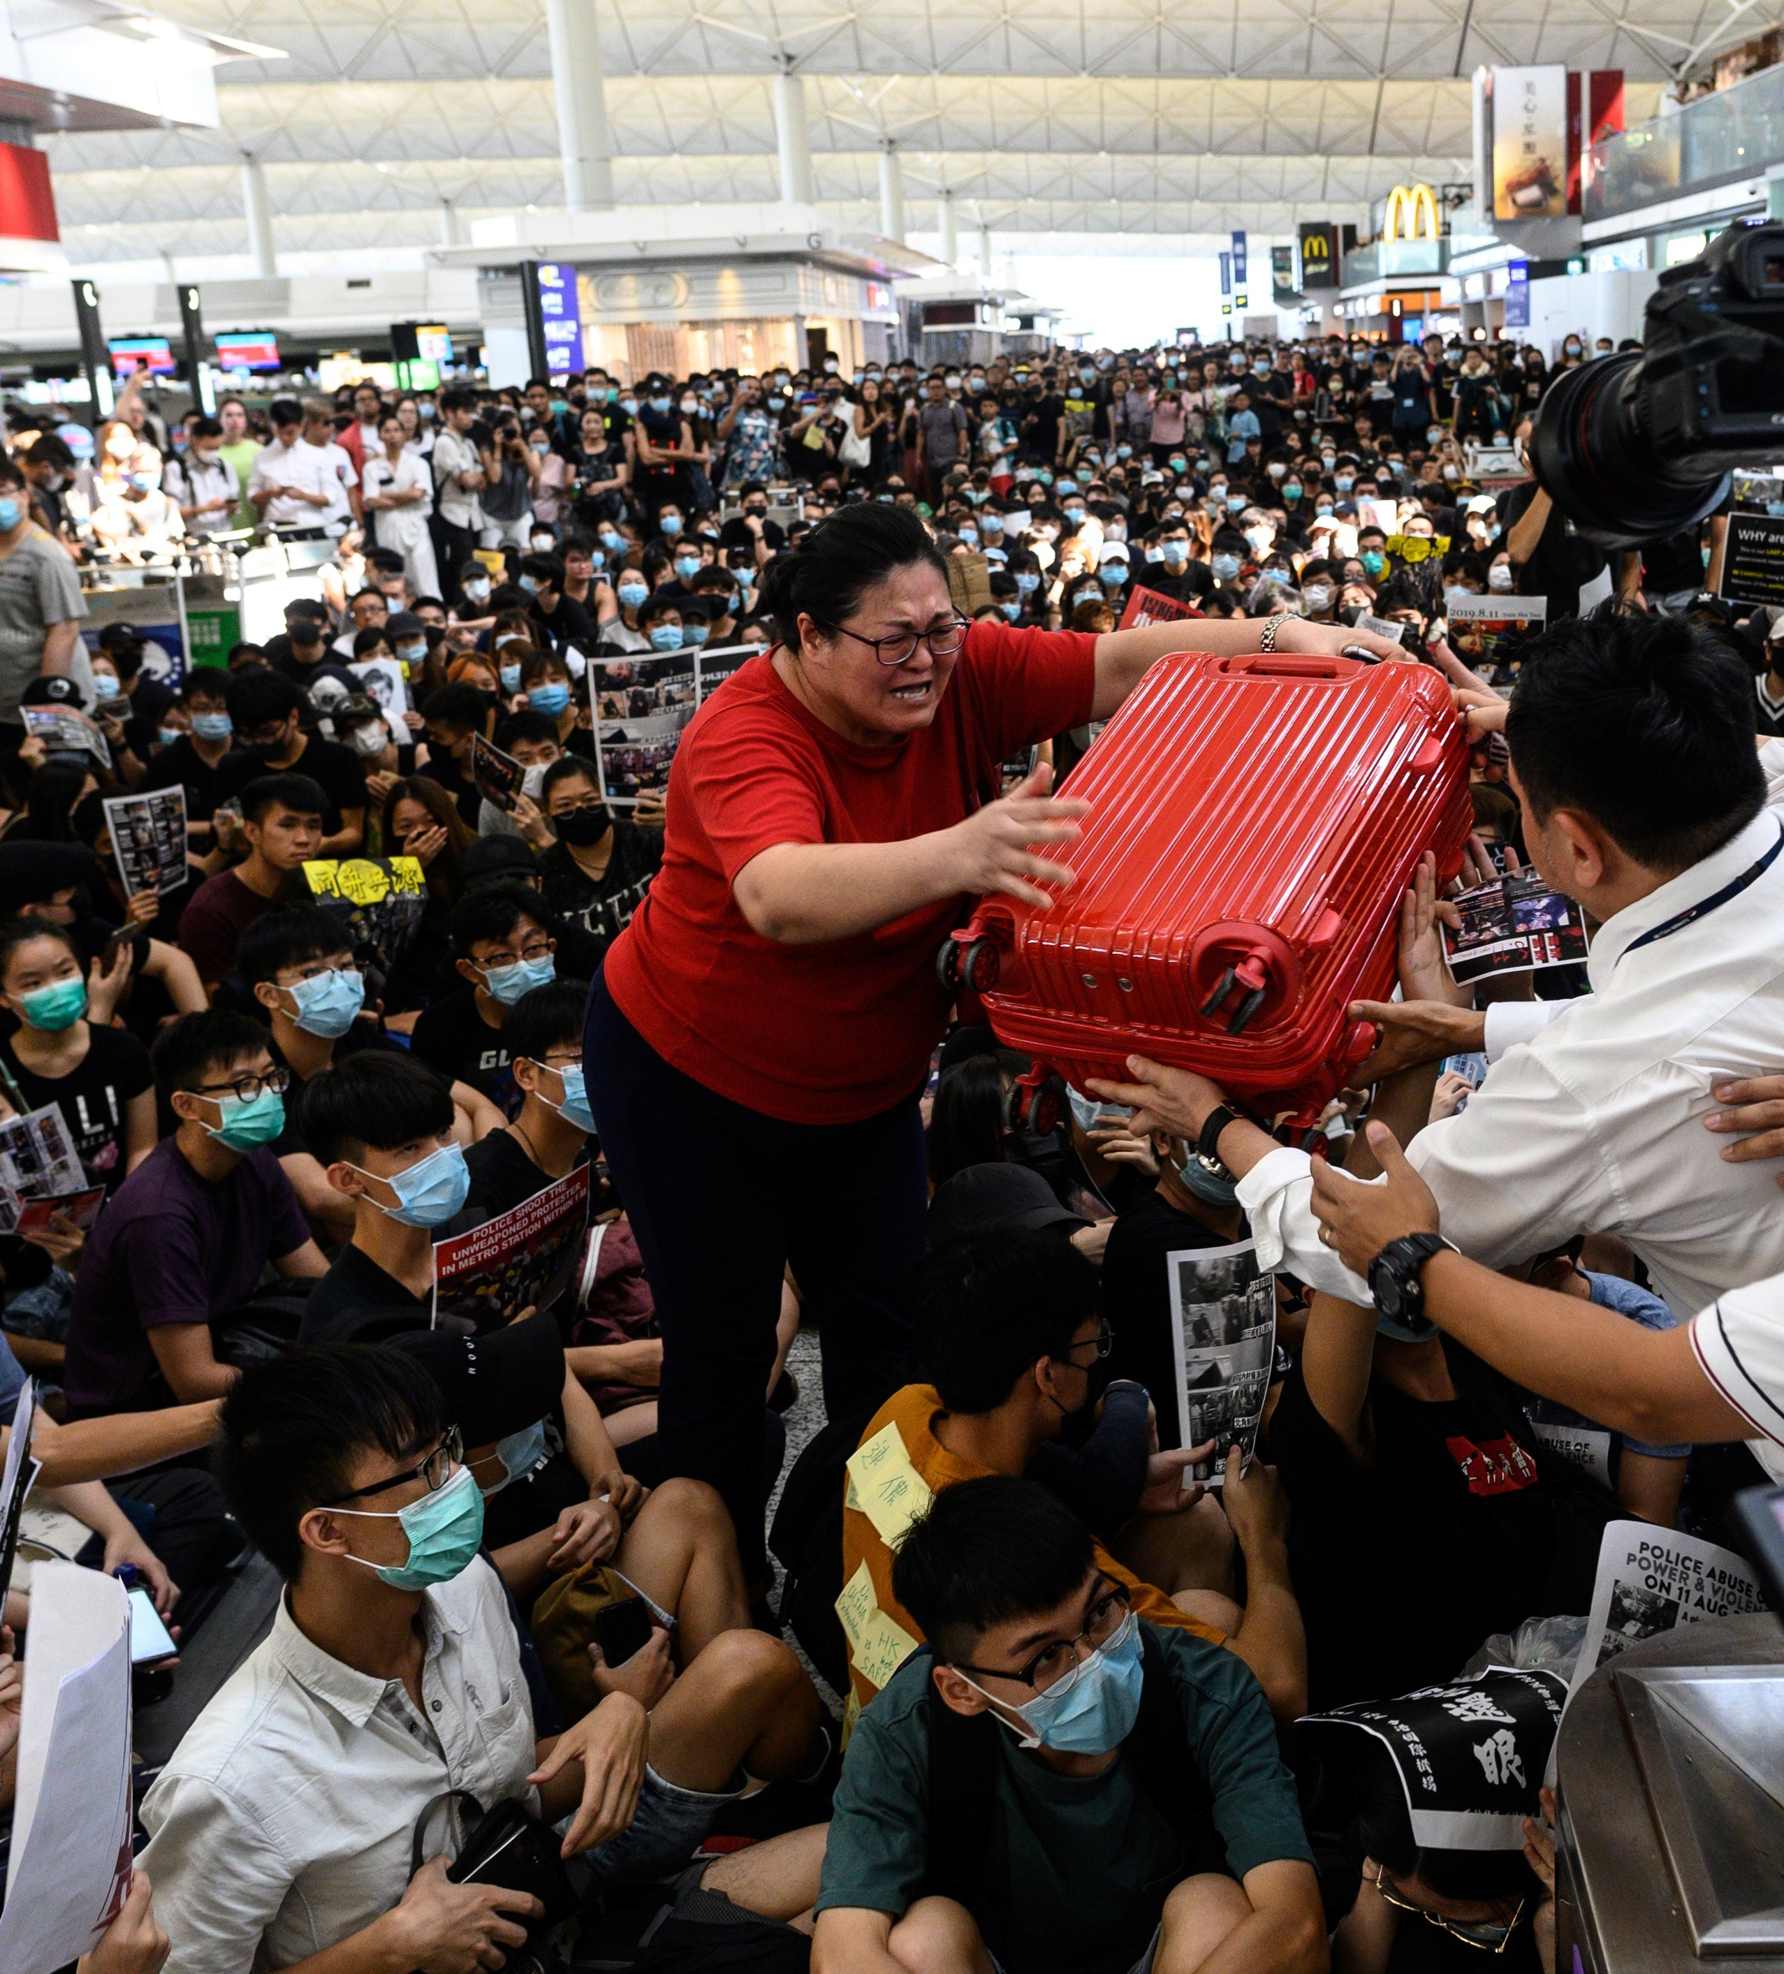
Problem Statement
Business Problem
Data Preparation and Analysis
Machine Learning Models
Conclusion
Cancelled flights are a pain for everyone involved
Airlines need to get passengers on separate flight which can be costly
Passengers miss meetings and big events
People get stressed and go crazy
Reasons flights get cancelled
Weather
Airline employees
Security
Not enough passengers
Covid
Solution
If we can predict flight cancellations ahead of time, we have a better chance to put passengers on separate flights and get them to their destination on time
This could be monetized as a form of insurance for passengers or cost minimization for airlines

Slide 5
Data
Business Problem
Data Preparation and Analysis
Machine Learning Models
Conclusion
Airport Location Data (Bureau of Transportation Statistics) 3.5 MB
Weather Data (National Oceanic and Atmospheric Administration) 105.2 GB
Flight Data 2018-2022 (Kaggle) 9.5 GB
Airline Employee Data (Bureau of Transportation Statistics) 302.9 KB

Slide 6
Data Cleaning and Aggregation
Business Problem
Data Preparation and Analysis
Machine Learning Models
Conclusion
Identify closest weather station to each airport using latitude and longitude
Filter weather data for observations from weather stations that are near an airport and replace missing values with zero
Merge flight data with weather data on closest time stamp and location for both departing airport and departure time and arrival airport and arrival time
Merge flight data with employee data by airline and month
Notes:
Unique weather station id and location coordinates
Built a function to find the weather station with the minimum distance to an airport
Create unique table for airport identifier and weather station identifier

Slide 7
Feature Engineering
Business Problem
Data Preparation and Analysis
Machine Learning Models
Conclusion
Airline employees per flight
Percent of employees that are full-time
Monthly change in airline employees per flight
Monthly change in percent of employees that are full-time
Final dataset of 35 GB

Slide 8
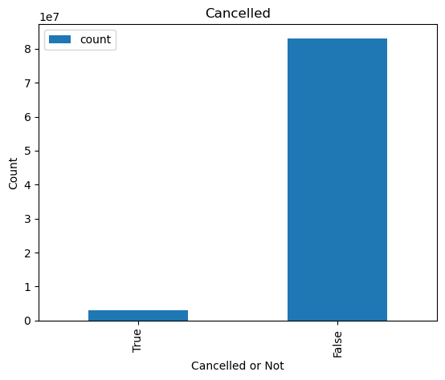
EDA-Visualize Raw Data and Target Variable
Business Problem
Data Preparation and Analysis
Machine Learning Models
Conclusion
86170785 Rows * 61 Columns
Cancelled | Number of Flights (Percentage)
True | 3127687 (3.6%)
False | 83043098 (96.4%)
Notes:
Our data contains approximately 80 million rows and 6 features. Each row represents a flight. And our features contain flight date, flight distance, airline, weather conditions of both origin and destination and so on. We started the EDA by doing univariate analysis. Down below is the distribution of our binary target variable, cancelled. We are going to use all other features to predict whether the flight is cancelled or not. Only 3.6% of data are labeled as cancelled while there are 96% labeled as not cancelled, which is quite imbalanced.

Slide 9
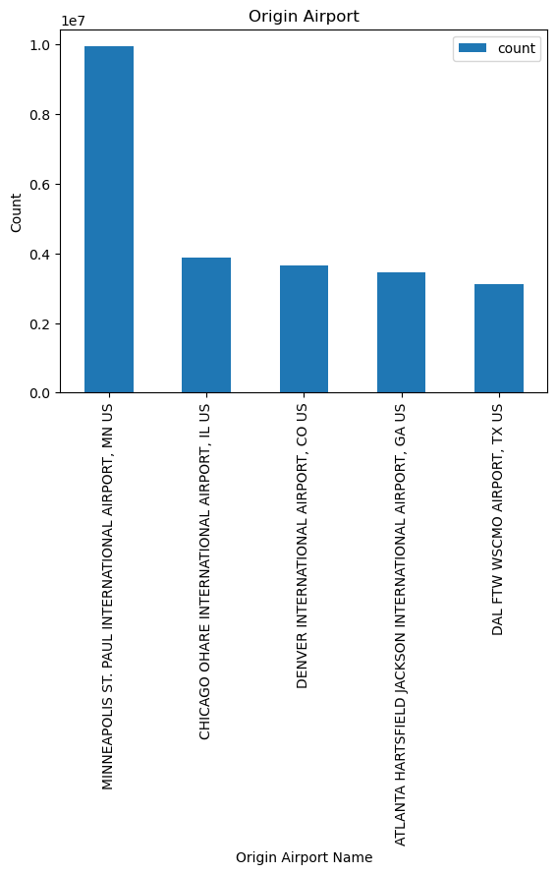
EDA-Univariate Analysis
Business Problem
Data Preparation and Analysis
Machine Learning Models
Conclusion
Airport | Number of Flights (Percentage)
Minneapolis St. Paul Intl. Airport | 9944032 (11.5%)
Chicago O'Hare Intl. Airport | 3871372 (4.5%)
Denver Intl. Airport | 3657574 (4.2%)
Atlanta Hartsfield Intl. Airport | 3447851 (4.0%)
Dallas FTW WSCMO Airport | 3130155 (3.6%)
Notes:
Here is a plot showing the top 5 airports which have the greatest number of flights in our dataset. Among all, Minneapolis St. Paul International Airport has the largest number of flights, accounting for 12% of all airports. In addition, four international airports located in Chicago, Denver, Atlanta, and Dallas share approximately the same proportion, which are around 4%. Surprisingly, airports in large cities on the east coast and west coast such as LAX and JFK do not show up here in the list. Probably because normally international flights are the majority in these two airports. And due to the pandemic, many them are cancelled. Therefore, the total number of flights shrinks.

Slide 10
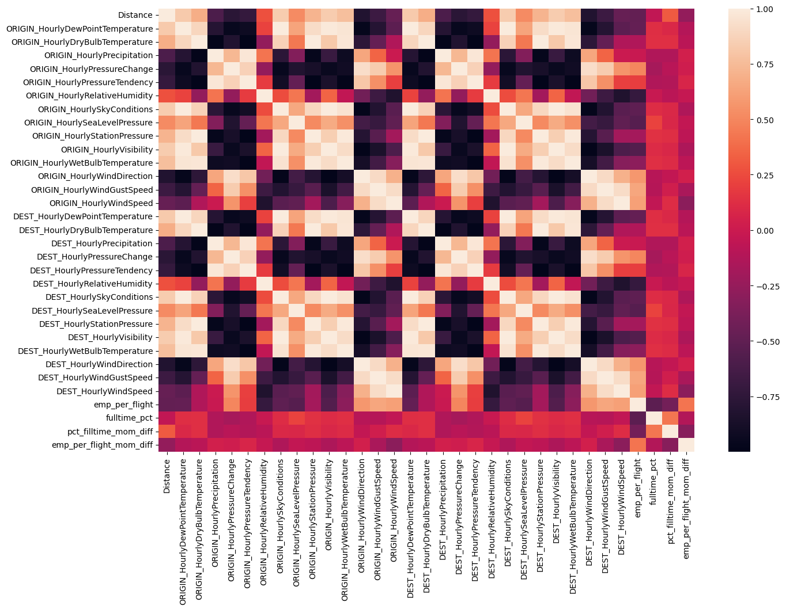
EDA-Multivariate Analysis
Business Problem
Data Preparation and Analysis
Machine Learning Models
Conclusion
Notes:
In this plot, the darker or the brighter the color is, the stronger the correlation is between the two variables. The brightness in the middle stands for weak correlation. And as you can see, there are many intercorrelated variables. Therefore, we would consider dropping some features or using L2 regularization to avoid multicollinearity later in the modeling process.

Slide 11
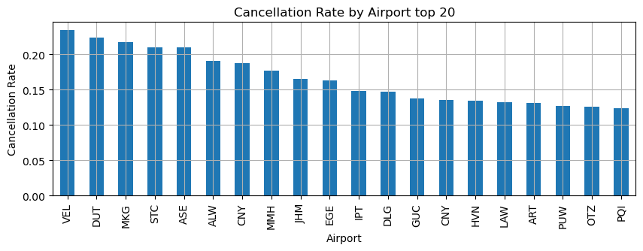
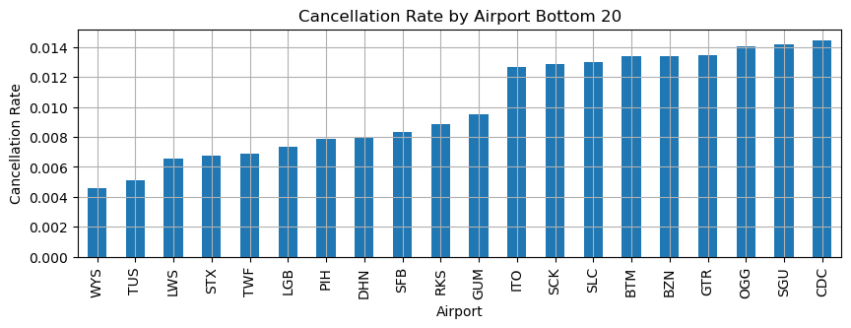
EDA-Multivariate Analysis
Business Problem
Data Preparation and Analysis
Machine Learning Models
Conclusion
Airports with Highest Cancellation Rates:
Vernal Regional Airport, Vernal, UT
Tom Madsen Unalaska Airport, Unalaska, AK
Muskegon County Airport, Muskegon, MI
St. Cloud Regional Airport, St Cloud, MN
Aspen/Pitkin County Airport, Aspen, CO
Airports with Lowest Cancellation Rates:
Yellowstone Airport-WYS, West Yellowstone, MT
Tucson International Airport, Tucson, AZ
Lewiston-Nez Perce County Regional Airport, Lewiston, ID
Henry E. Rohlsen International Airport, U.S. Virgin Islands
Magic Valley Regional Airport, Twin Falls, ID
Notes:
These two plots show the top airports which have the highest and lowest cancellation rate. The cancellation rate can reach up to above 20% and can be down to 0.4%. In addition, the top 5 airports with the highest cancellation rates are all small-scale such as regional or county airport.

Slide 12
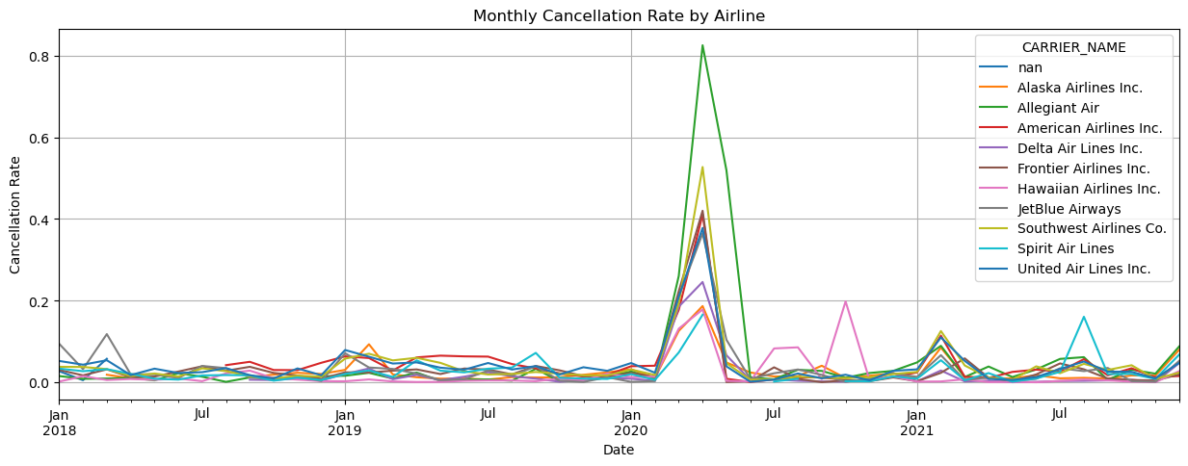
EDA-Multivariate Analysis
Business Problem
Data Preparation and Analysis
Machine Learning Models
Conclusion
Most of the airlines’ cancellation rates peak at around March 2020, when pandemic started.
Notes:
This plot is showing each airline’s monthly cancellation rate. The cancellation rates are quite stable before January 2020 around the beginning of the pandemic. After that, the cancellation rate increased rapidly. It peaked in April and decreases to the normal level in June. After that, there are multiple fluctuations. The number and the amplitude of fluctuations after the pandemic seem to be greater than those before the pandemic.

Slide 13
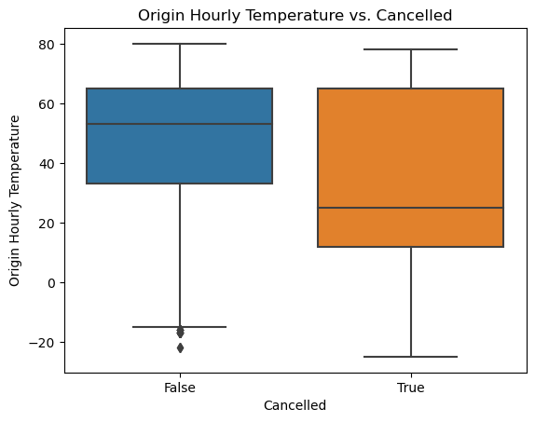
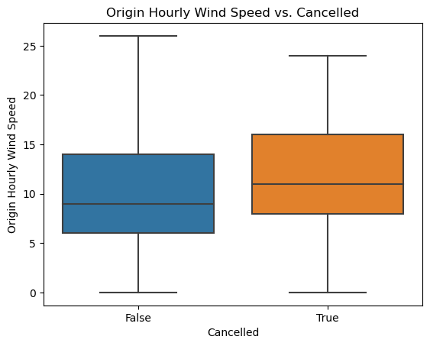
EDA-Multivariate Analysis
Business Problem
Data Preparation and Analysis
Machine Learning Models
Conclusion
Origination hourly temperatures for flights that are not cancelled are higher than those for flights that are cancelled on average.
Origination hourly wind speed for flights that are not cancelled are lower than those ofr flights that are cancelled on average.
Notes:
The side-by-side boxplot on the left shows the distribution of origin hourly temperature versus cancelled. And the plot on the right shows the origin wind speed versus cancelled. Weather condition plays an important row in determining whether the flight is cancelled or not. As you can see, the average origin temperature for flights that are cancelled are lower than those not. And the average origin wind speed for the flights that are cancelled are higher those not cancelled.

Slide 14
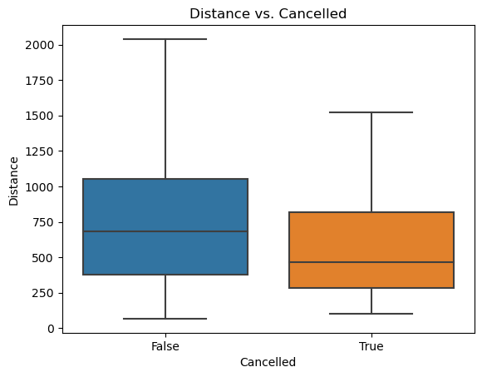
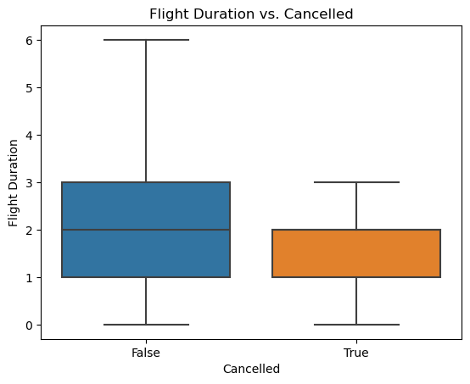
EDA-Multivariate Analysis
Business Problem
Data Preparation and Analysis
Machine Learning Models
Conclusion
Short-distance and short-time flights are more likely to be cancelled than long-distance and long-time flights on average.
Notes:
And these two plots show the distribution of distance and flight duration versus cancelled. From the plots we can see that short-distance and short-time flights are more likely to be cancelled than long-distance and long-time flights on average.

Slide 15
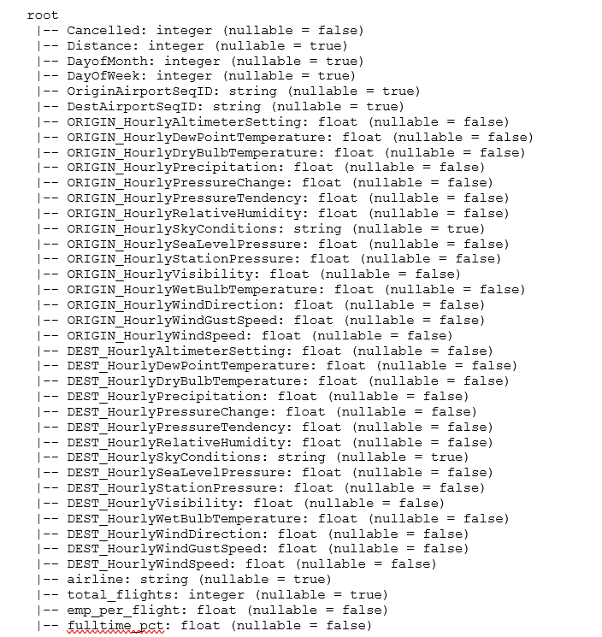
Baseline Model: Logistic Regression
Business Problem
Data Preparation and Analysis
Machine Learning Models
Conclusion
◉DATA
Utilized weather features, airline company, airport location, employment information by airline
Cancelled = 1 if cancelled else 0
Imputed null numeric values with 0
One-hot encoded categorical variables
VectorAssembler combine features into single vector column
Removed data from Feb-June 2020
Around 24 million rows and 446,189 features
80/20 split for train/test
Utilized Dataproc on GCP with 2 nodes and 500GB of disk size each and multiple clusters
Notes:
We utilize most of the weather data
From the flight data, we look at if the airline and airport matters
We look at the impact of fulltime and parttime employees
We had some null values of weather data such as precipitation, this is most likely because there was no rain so imputed the null values to 0
We also removed months that were affected by the early months of covid. Overall, we had around 24 million rows and around 446 thousand features

Slide 16
Baseline Model: Logistic Regression
Business Problem
Data Preparation and Analysis
Machine Learning Models
Conclusion
◉Results
High Accuracy and F1 Score due to unbalanced dataset
Took around 5 hours to run
 | Model predicts no cancellation | Model predicts cancellation
When flights were not cancelled | 99.82% | 0.18%
When flights were cancelled | 86.87% | 13.13%
Accuracy | F1 Score
97.34% | 96.47%
Notes:
Our baseline model was a simple logistic regression
It took around 5 hours to run
Even though the f1 score and accuracy score is high, if we dig a little deeper, the model seems to be just predicting flights won't be cancelled due to the data imbalance
I believe we have 97% flights that were not cancelled and only 3% that was cancelled in the dataset.

Slide 17
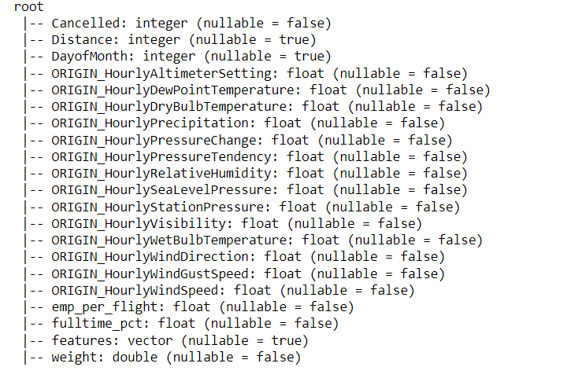
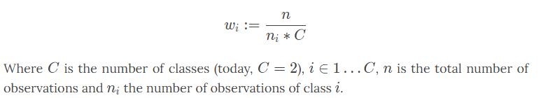
Model2: Logistic Regression
Business Problem
Data Preparation and Analysis
Machine Learning Models
Conclusion
◉DATA
Dropped highly correlated variables
Impute null numeric values with 0
Added weight column to balance dataset
Removed categorical variables to reduce run time and interpretability issue
Around 7 million rows
Notes:
For our 2nd model, we decided to drop the highly correlated variables. For example, the destination precipitation were highly correlated with the origin precipitation
We also dropped the categorical variables due to difficulty in interpreting the values. For example, there are thousands of airports and airline in the dataset so looking at the effect of one would be difficult.
We used a weight method that is popular in the ML community even though it is a subjective topic.

Slide 18
Model2: Logistic Regression
Business Problem
Data Preparation and Analysis
Machine Learning Models
Conclusion
◉Results
Took around 30-45mins to run
Accuracy and F1 Score drops
We prefer a higher percentage of true cancellation prediction even if it reduces our accuracy and F1 Score
Using several regularization parameters led to low accuracy and F1 score so we stuck with this model
 | Model predicts no cancellation | Model predicts cancellation
When flights were not cancelled | 69.69% | 30.31%
When flights were cancelled | 39.26% | 60.74%
Accuray | F1 Score
69.47% | 79.80%
Notes:
Time to run the 2nd mode was cut significantly from 5hrs to 45min
Even though our F1 score and accuracy dropped, we prefer this model because we are more interested in get a true positive value, which mean we are better at predicting if a flight actually gets cancelled.
If we predict a flight will not get cancelled but it actually does, it will cause more issues than if we predict a flight that will get cancelled and it does not. So we are willing to take a lower Accuracy and F1 score for this.
We also used several regularization parameters but it was worst than a non-regularized model.

Slide 19
Model3&4: Gradient-Boosted Trees
Business Problem
Data Preparation and Analysis
Machine Learning Models
Conclusion
◉Results
Took around 30-45mins to run
Model with weight: Accuracy Score=75.68% F1 Score =85.01%
Model without weight: Accuracy Score=97.48% F1 Score = 96.31%
Model with weight an approvement over Logistic Regression
Without weight | Model predicts no cancellation | Model predicts cancellation
When flights were not cancelled | 99.98% | 0.02%
When flights were cancelled | 97.87% | 2.13%
With weight | Model predicts no cancellation | Model predicts cancellation
When flights were not cancelled | 75.95% | 24.05%
When flights were cancelled | 34.32% | 65.68%
Notes:
Our third model was a Gradient-Boosted Trees without weights.
Model without weight had a balanced issue similar to logistic regression without weight
Model with weight out performed logistic regression with weight in true flight cancellation and reduces false cancelation as well so this model is an improvement from the logistic regression with weight

Slide 20
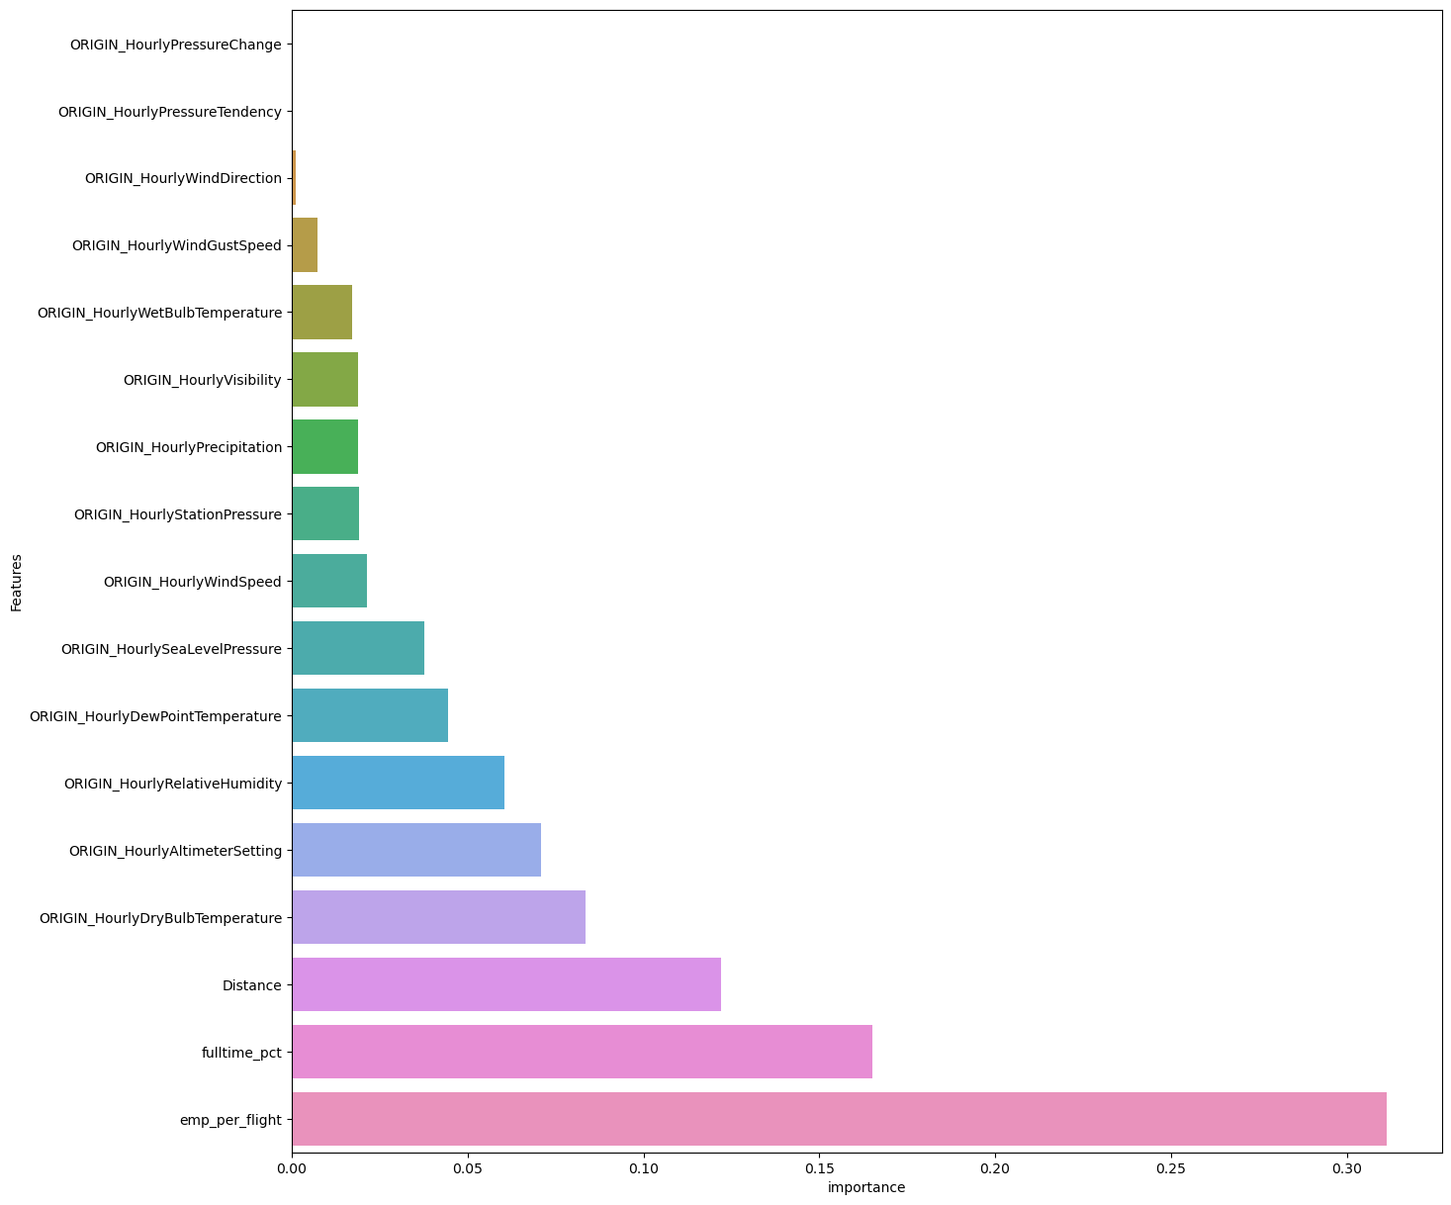
Gradient-Boosted Trees: Feature Importance
Business Problem
Data Preparation and Analysis
Machine Learning Models
Conclusion
◉Importance
Employee per flight, full-time employee %, and distance of flight were the top 3 important features
Notes:
For the Gradient-Boosted Trees, total flights, part-time employee and day of month were the most important features.
Intuitively, having more flights should result in more cancellation just like how you would expect Delta airlines to have more flight cancellation than a regional airline just due to sheer total volume
Part-time employee and full-time employee are both in the top 5 most important features. We have all heard about airline worker shortage causing flight cancellation in the news this year as part of a labor shortage trend industry wide
A little surprising how day of the month was more important than weather

Slide 21
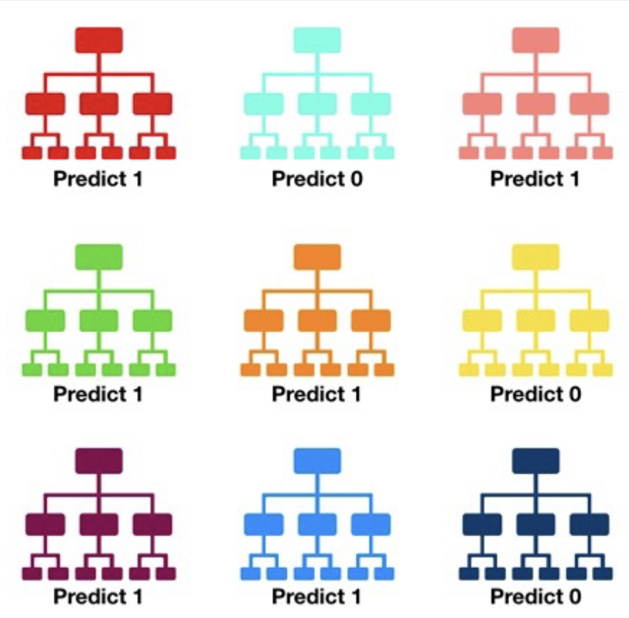
Random Forest Classification
Business Problem
Data Preparation and Analysis
Machine Learning Models
Conclusion
Random forest model:
Handle categorical and continuous variables
Reduce overfitting in decision tree
Automatically handle missing values and outliers
Model with added weight: Accuracy: 95.744% F1 score: 93.662%
Model without added weight: Accuracy: 82.501% F1 score: 87.150%
Without weight | Model predicts no cancellation | Model predicts cancellation
When flights were not cancelled | 100% | 0%
When flights were cancelled | 99.997% | 0.002%
With weight | Model predicts no cancellation | Model predicts cancellation
When flights were not cancelled | 84.080% | 15.920%
When flights were cancelled | 53.015% | 46.985%

Slide 22
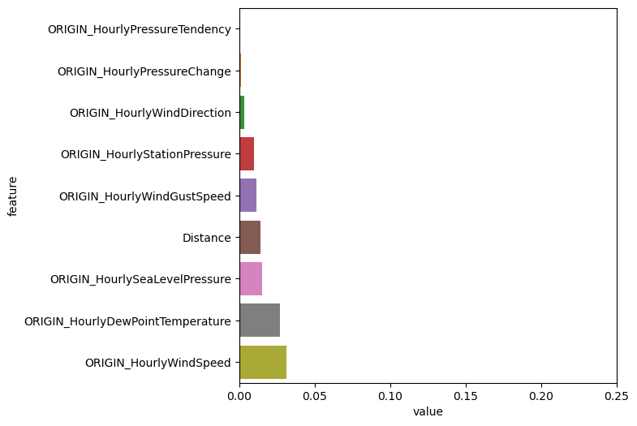
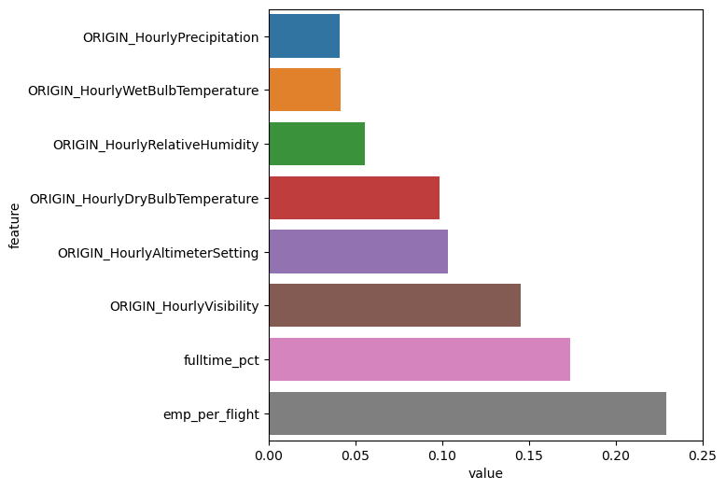
Random Forest: Feature Importance
Business Problem
Data Preparation and Analysis
Machine Learning Models
Conclusion

Slide 23
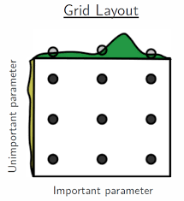
Random Forest: Hyperparameters Tuning
Business Problem
Data Preparation and Analysis
Machine Learning Models
Conclusion
Grid search on
Number of tree: 300, 400
Maximum depth: 6, 8
Maximum number of bins: 64, 128
With evaluation matrices:
F1 score
Accuracy
Number of tree | Maximum depth | Maximum number of bins | Final f1 score | Final accuracy
200 | 8 | 128 | 91.141% | 88.072%

Slide 24
Key Takeaways
Business Problem
Data Preparation and Analysis
Machine Learning Models
Conclusion
Gradient Boosting Tree is the best model given its high F1 score and accuracy for the model without added weight and its highest true positive rate for model with added weight
The most important factors that affect flight cancellation are
Percent of full-time employees
Employees per flight
Origin visibility
Dry bulb temperature
Altimeter setting

Slide 25
Challenges
Business Problem
Data Preparation and Analysis
Machine Learning Models
Conclusion
Baseline model took around 5 hours to run due to the size of the dataset. We cut the run-time to 30-120 minutes (depending on the type of model we ran) by dropping highly correlated features and categorical features. We also used multiple clusters to run several models simultaneously. We couldn't increase the numbers of nodes and disk size due to our low GCP credits
We also tried to conduct a larger grid search for model optimization but due to the limited time and GCP credit, we could only run a small grid search with 2 values per hyperparameters. But even with such small grid search, it takes more than 8 hours to get the result
No columns to join weather dataset and flight dataset so we had to create our own linking table

Slide 26
Limitations and Future Work
Business Problem
Data Preparation and Analysis
Machine Learning Models
Conclusion
Adjust the hyperparameters of and add some regularization on the existing models
Explore more models with fine tuning
Include more categorical variables
Add cross validation instead of just train and test
Use graph database to identify routes with lowest probability of being cancelled
After the model is completed, deploy the model on App.

